Slide 1



PULMONARY REHABILITATION
ERICK OUMA
MSC-Respiratory medicine: University of Chester
BSC-PT: Moi University
Cert: PR, NIV and MV: University Hospitals Dorset
Practice Educator: University of Winchester
SENIOR RESPIRATORY PHYSIOTHERAPIST
VISITING LECTURER

Slide 2

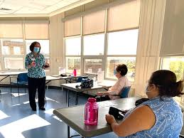
Pulmonary Rehabilitation
Pulmonary rehabilitation (PR) is an interdisciplinary program of care for patients with chronic respiratory impairment which is individually tailored and designed to optimize each patient’s physical and social performance (ESR,2006)
+
Exercise training
Education

Slide 3
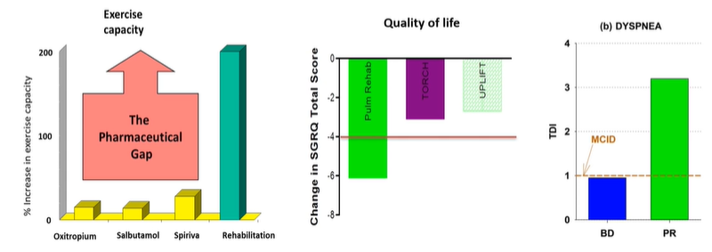
PR is the cornerstone of managing COPD
PR provides greater improvements in exercise capacity, quality of life and dyspnea in COPD than inhalers
Casabur et al.,2018

Slide 4
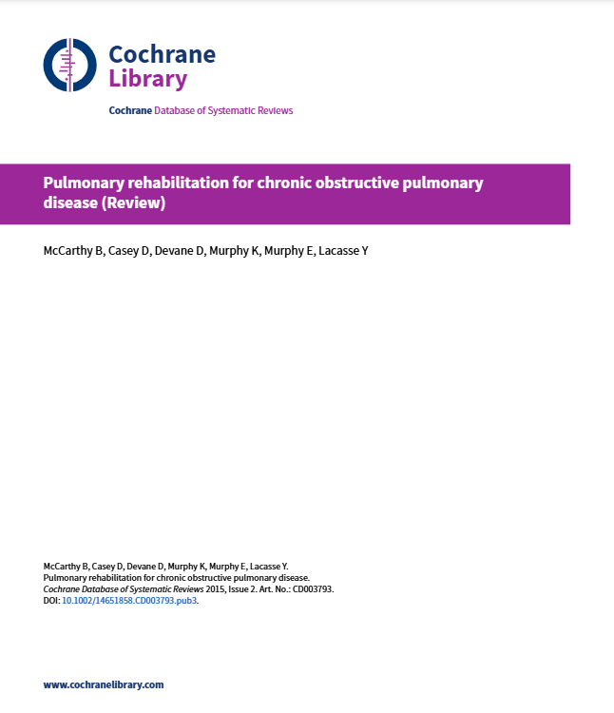
Benefits of PR
Post hospitalization PR
A meta-analysis of 65RCT, 3822 participants
PR improves
Health related quality of life
Functional and maximal exercise capacity
Dyspnea and fatigue
Emotional function and sense of control
Cornerstone in management of COPD
PR is fundamental rather than optional extra
No further RCTS were needed comparing PR to usual care
McCarthy et al.,2015

Slide 5
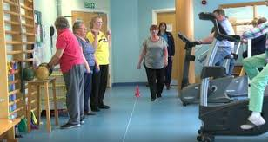

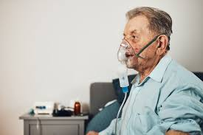
Benefits of PR
Post hospitalization PR for pts with AECOPD
20 studies,1477 participants
Reduces readmission
Improves health quality of life
Improves exercise capacity
Puhan et al.,2016

Slide 6
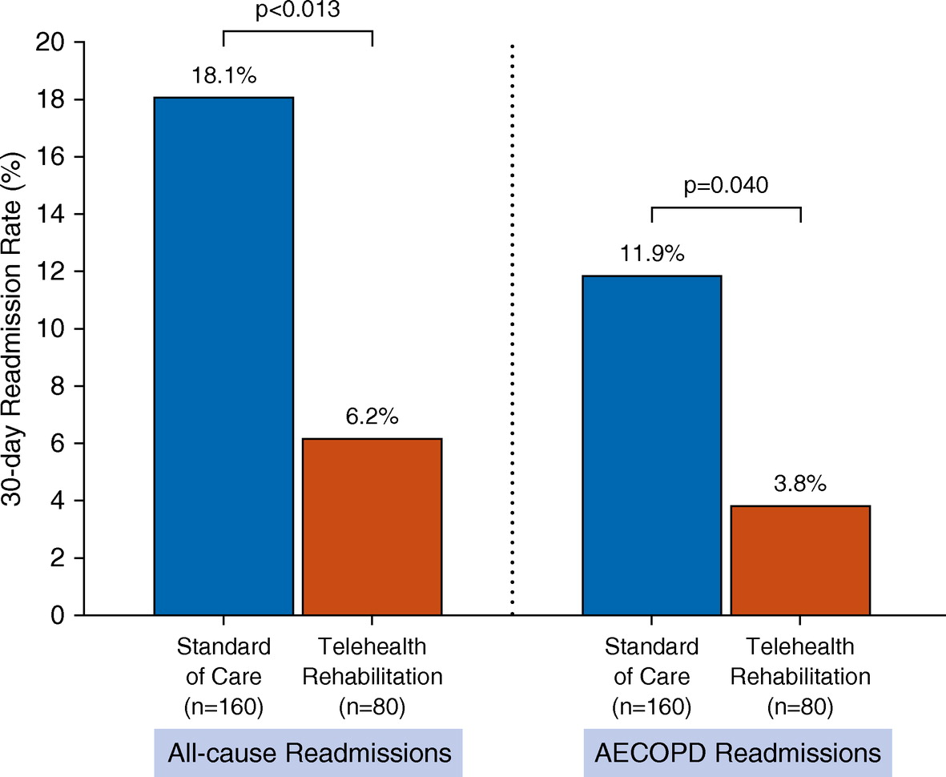
Benefits of PR
Bhatt SP et al.,2019
Hospital readmissions

Slide 7
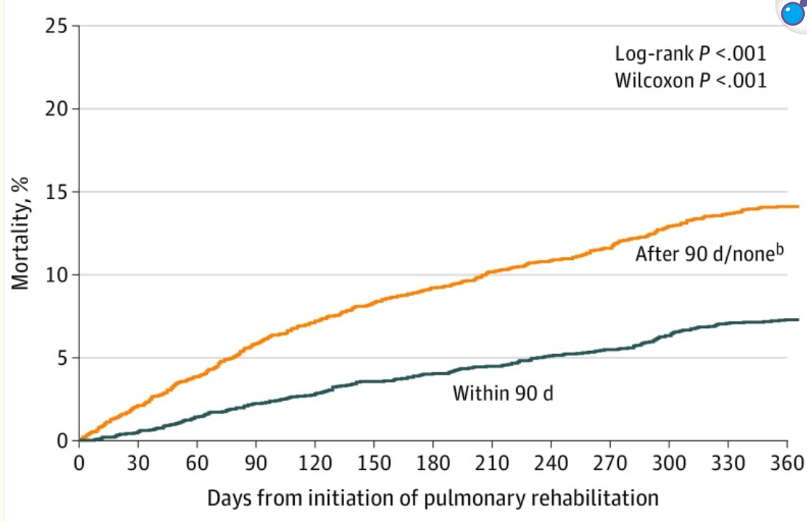
Post hospitalization PR and Mortality
Benefits of PR
Lindenauer et al.,2020
PR within 90 days= lower risks of death over 1 year

Slide 8
Who can participate in PR
(Tonga and Oliver.,2023)
PR
COPD
ILD
Post-TB
Pre-Post lung transplant
Lung cancer
Post Covid-19
(Hoffman et al.,2017)
(Dowman et al.,2021)
Lung reduction surgery
Asthma
(Ando et al.,2003)

Slide 9
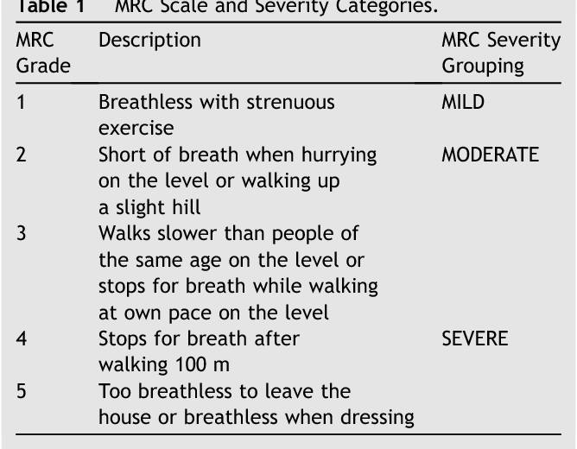
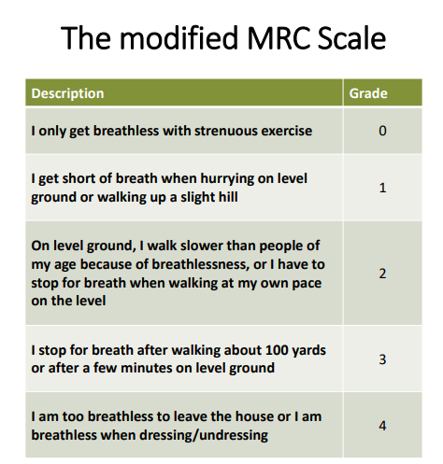
Initial assessment
General eligibility criteria
Optimal medical management
Breathlessness resulting in functional impairments
COPD-MRC; 2-5
Chronic lung condition,MRC;3-5
Man et al.,2023

Slide 10
Initial assessment
Disease specific eligibility criteria
Optimization of airway clearance before PR
Bronchiectasis
Referred to PR at hospital discharge
Hospitalized COPD exacerbation
Pulmonary arterial hypertension or thromboembolic pulmonary hypertension
No change in drug therapy or dose in previous 2 months
No syncope or arrhythmias in last 2 months
Pulmonary Hypertension
Man et al.,2023

Slide 11
Contraindication of PR
Initial assessment
Unstable cardiac disease e.g unstable angina, unstable arrhythmias, abdominal aortic aneurism >5.5cm
Locomotor or neurological condition that preclude exercise e.g severe arthritis
Terminal phase of illness
Significant cognitive or psychological impairment.
Sharma, Singh.,2011

Slide 12
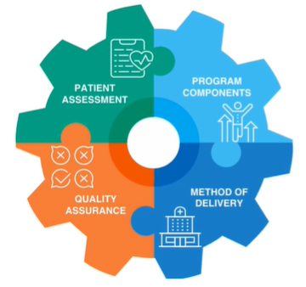
Essential components of PR
High-quality, in-person, multisystem assessment
Hybrid assessment only if in-person assessment is restricted
Questionnaire by telephone
Exercise capacity measured in-person
Assessment protocol
Standard operating procedures
Trained and competent
Chen et al.,2021

Slide 13

Purpose of initial assessment
Explore patient’s understanding of PR and address concerns
Assess for contraindications to inform safety and suitability for PR
Assess outcome measures;
Inform exercise prescription
Measure disease impact and burden
Act as a comparator for the discharge assessment
Support patient to set a SMART goal
Man et al.,2023

Slide 14

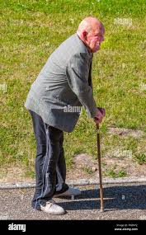
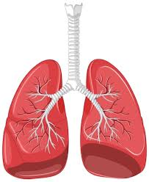
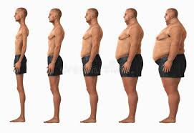


Purpose of initial assessment
Identify and refer individuals who would benefit from other interventions or treatment of comorbidities
Cardiovascular disease: Hypertension, arrhythmias, unexplained chest and or intermittent claudication
Frailty
Long-term Oxygen use
High or low body mass index
Psychological symptoms
Impairment in activities of daily living
Man et al.,2023

Slide 15

Components of initial assessment: Subjective
Patient’s main problem
Understanding of PR, expectations, concerns, goal(s)
Histories: Past medical, medication, social
Status: Mobility, smoking
Impact of lung condition including hospitalization and exacerbations
Prescription of supplementary oxygen, non-invasive ventilation
Rochester,2019

Slide 16
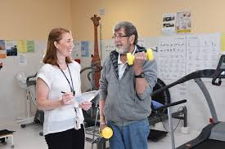
Component of initial assessment: Objective
Cardiorespiratory observations e.g SPO_{2 ,}heart rate, BP
Body mass index
Core outcomes
Breathlessness
Health related quality of life
Exercise capacity
Lower limb muscle strength
Educational needs
Rochester,2019

Slide 17

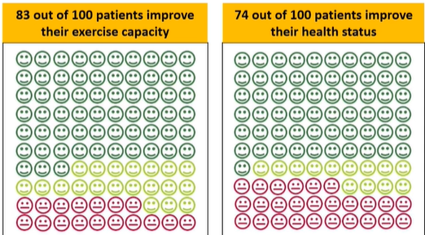
PR in real life
Clinical audit of Pulmonary Rehabilitation services in England and Wales 2015
210 PR services n=7413

Slide 18
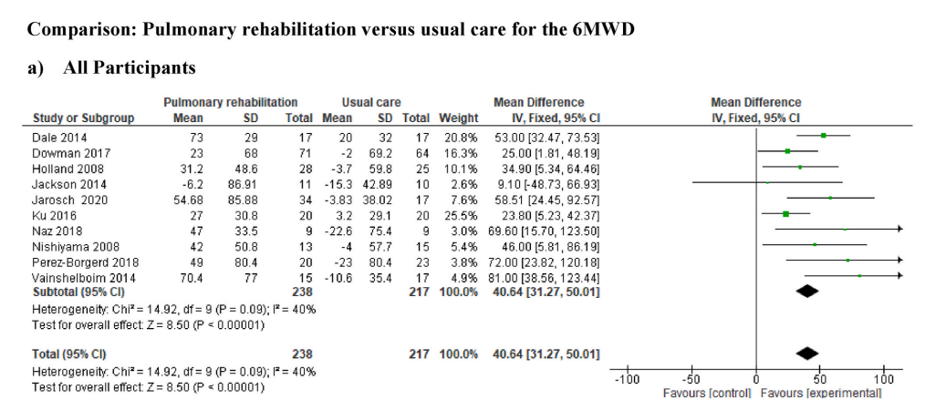
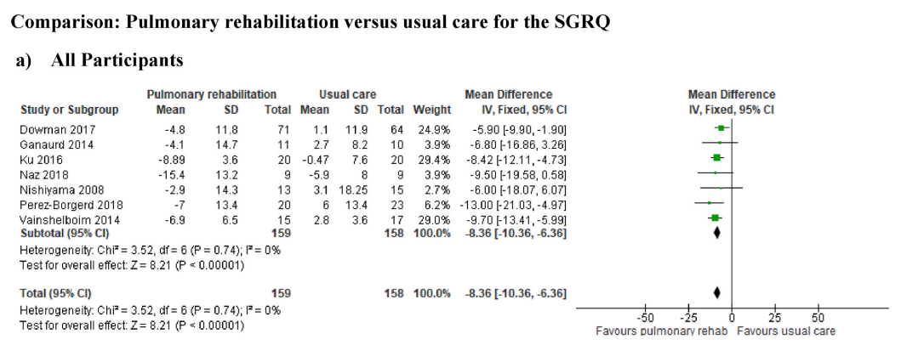
PR AND ILD
SR with 11 RCTs from 8 countries with 476 ILD patients. 10 studies provided data for exercise capacity (6MWD) and 7 studies for HRQoL (SGRQ)
PR Programs > eight weeks increased 6MWD (45m)more than the MCID (24-45m) compared to shorter programs.
Importantly, 6MWD is highly predictive of mortality; a 24-week decline of greater than 50 m is associated with a fourfold increase in risk of death at 1 year (hazard ratio, 4.27; 95% confidence interval, 2.57– 7.10; P , 0.001). Roland et al,.2021
Analysis showed that PR significantly improved the quality of life (SGRQ Total) (MD = −8.36, 95 % CI: 10.36 to −6.36, P < 0.00001)
Salazaret al,.2025

Slide 19
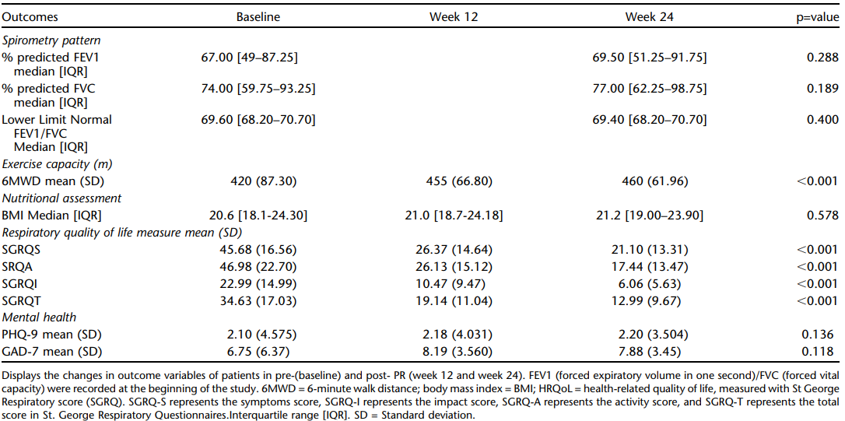























Pulmonary rehabilitation for post-TB lung disease
Mtei et al,.2025

Slide 20
Case study 1
A 73-year-old male patient diagnosed with COPD (mMRC/GOLD stage 4) with a poor prognosis of approximately six months.
The patient was initiated on PR X2 alongside chest physiotherapy for about three months while on portable home mechanical ventilation.
Subsequently, the patient was successfully weaned from mechanical ventilation, and nocturnal NIV was initiated.
PR frequency was then reduced to X3 per week.
With this management, the patient achieved a satisfactory quality of life and survived approximately two years beyond the initially expected prognosis

Slide 21
Case study 2
A 30-year-old female patient was referred for (PR) two years after completing treatment for TB. On presentation, she reported symptoms consistent with active TB, including cough, fatigue, and breathlessness; however, all diagnostic tests for TB returned negative.
In view of her clinical history and symptoms, she was commenced on prophylactic TB therapy, and pulmonary rehabilitation was initiated to support her respiratory recovery, improve exercise tolerance, and enhance quality of life

Slide 22


Baseline assessment
Vitals | Outcome measure tools | Symptoms | Goals
BP-115/78 | 6MWT-45m Borg 5 | Regular bothering productive cough (copious amount of thick frothy secretions) | To regain the ability to perform activities of daily living (ADLs) independently.
SPO2-88% on RA | mMRC-3 | Dyspnea with exertion | To be able to return home
HR 137bpm | SF-36, 25-fair | Not able to carry out ADL
 | SGRQ-47%

Slide 23
PR Program
10 Exercise domains | Nutritional support | Respiratory adjuncts | Psychological support | Home program
 | Put on diet, blending traditional and modern food | Nocturnal oxygen support OPEP device Regular nebs Inhaler | Engaged a counsellor Encouraged to call back home regularly Direct family engagement | Walking Stairs climbing
Session 1 | Session 2 | Session 3 | Session 4 | Session 5
Managed only 6 different exercise domains, Borg-3 and rep 6 | 7 domains, Borg-3, repetition of 15 | 6 domains, Borg 4, repetition 20, weight 2kg | 8 domains, Borg 3, repetition 25, weight 2.5kg | Readmitted

Slide 24
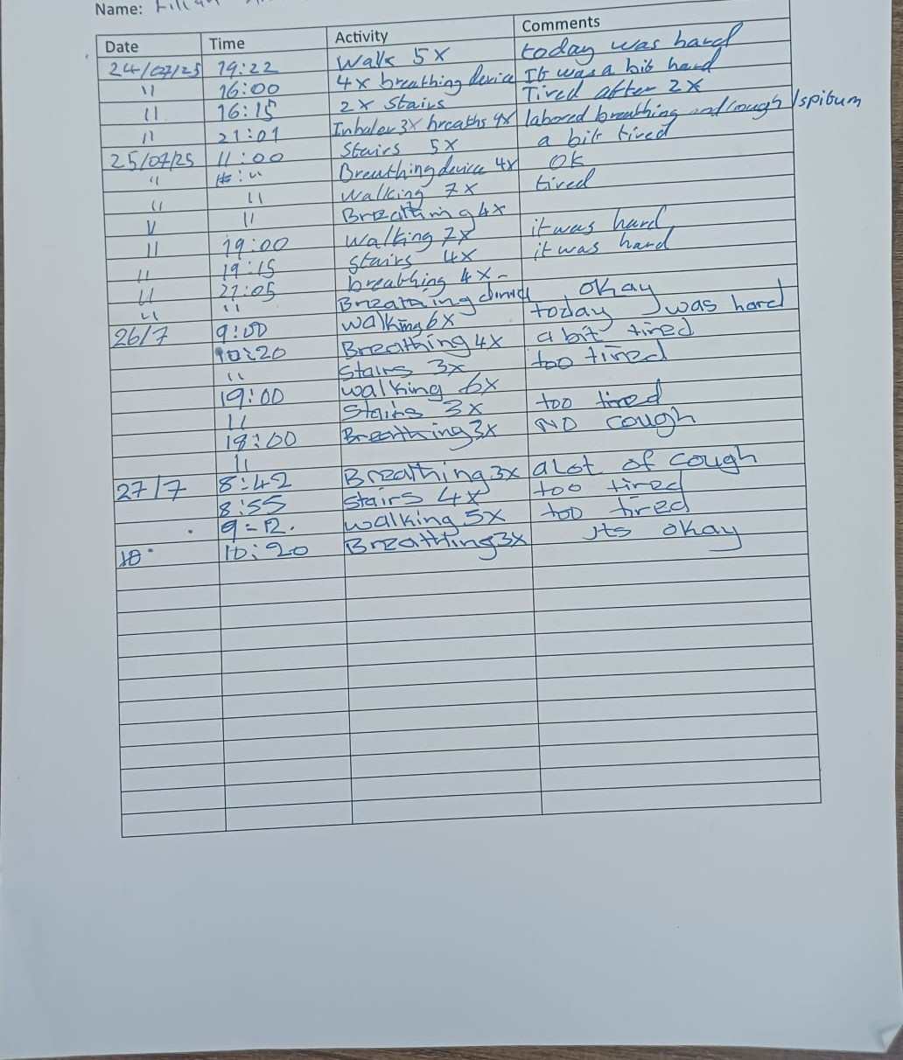
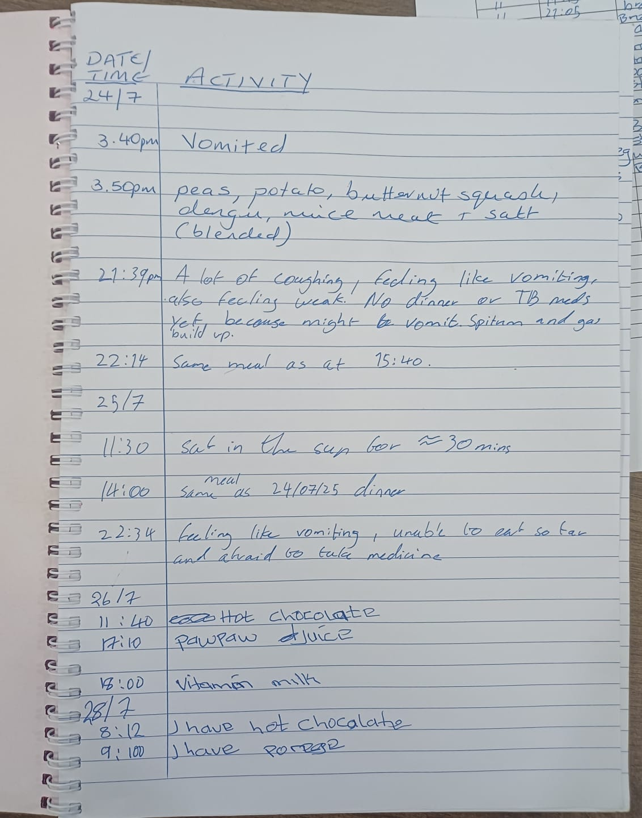
2 weeks in rehab, she was able to go up and down 2 flights of stairs X5 per day. She also started ADL (light duties such as washing utensils)

Slide 25
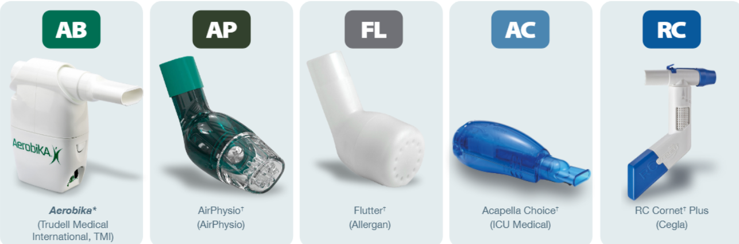
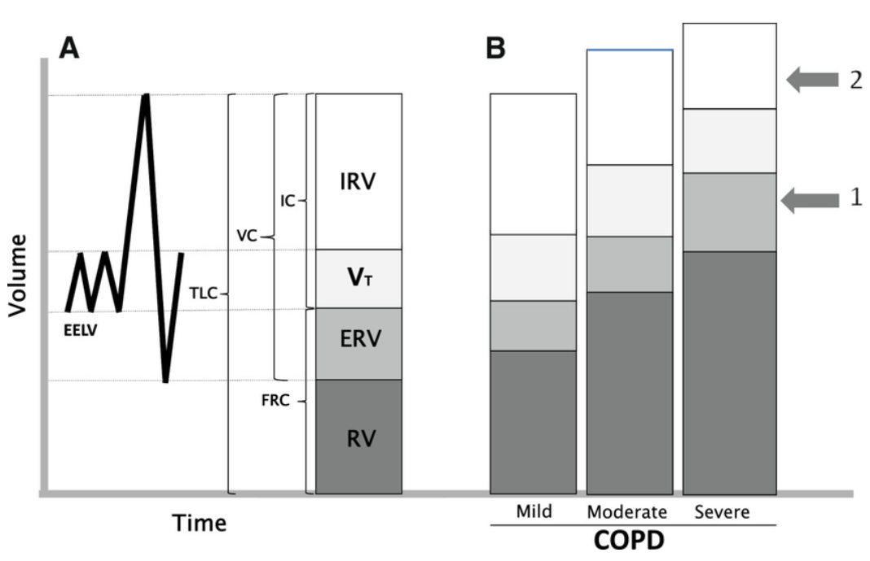
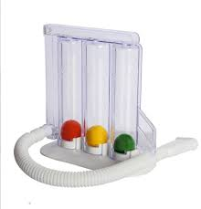
Hyperinflation in COPD
Normal lung
COPD lung
IRV
V_{T}
ERV
RV
Sanguinetti et al. 2014.

Slide 26


Thank you

Slide 27
List of reference
1.Nici L, Donner C, Wouters E, Zuwallack R, Ambrosino N, Bourbeau J, et al. American Thoracic Society/European Respiratory Society statement on pulmonary rehabilitation. Am J Respir Crit Care Med. 2006;173(12):1390-413.
2.Ferreira G, Feuerman M, Spiegler P. Results of an 8-week, outpatient pulmonary rehabilitation program on patients with and without chronic obstructive pulmonary disease. J Cardiopulm Rehabil. 2006;26(1):54-60.
3.Ando M, Mori A, Esaki H, Shiraki T, Uemura H, Okazawa M, Sakakibara H. The Effect of Pulmonary Rehabilitation in Patients With Post-tuberculosis Lung Disorder. CHEST. 2003;123(6):1988-95.
4.Adegunsoye A, Strek ME, Garrity E, Guzy R, Bag R. Comprehensive Care of the Lung Transplant Patient. Chest. 2017;152(1):150-64.
5.Sharma BB, Singh V. Pulmonary rehabilitation: An overview. Lung India. 2011;28(4):276-84.
6.Gordon CS, Waller JW, Cook RM, Cavalera SL, Lim WT, Osadnik CR. Effect of Pulmonary Rehabilitation on Symptoms of Anxiety and Depression in COPD: A Systematic Review and Meta-Analysis. Chest. 2019;156(1):80-91.
7.Bestall JC, Paul EA, Garrod R, Garnham R, Jones PW, Wedzicha JA. Usefulness of the Medical Research Council (MRC) dyspnoea scale as a measure of disability in patients with chronic obstructive pulmonary disease. Thorax. 1999;54(7):581-6.
8.Man W, Chaplin E, Daynes E, Drummond A, Evans RA, Greening NJ, et al. British Thoracic Society Clinical Statement on pulmonary rehabilitation. Thorax. 2023;78(Suppl 4):s2-s15.
9.Lindenauer PK, Stefan MS, Pekow PS, Mazor KM, Priya A, Spitzer KA, et al. Association Between Initiation of Pulmonary Rehabilitation After Hospitalization for COPD and 1-Year Survival Among Medicare Beneficiaries. Jama. 2020;323(18):1813-23.
10.Ando M, Mori A, Esaki H, Shiraki T, Uemura H, Okazawa M, Sakakibara H. The effect of pulmonary rehabilitation in patients with post-tuberculosis lung disorder. Chest. 2003;123(6):1988-95.

Slide 28
List of reference
11.Bhatt SP, Patel SB, Anderson EM, Baugh D, Givens T, Schumann C, et al. Video Telehealth Pulmonary Rehabilitation Intervention in Chronic Obstructive Pulmonary Disease Reduces 30-Day Readmissions. Am J Respir Crit Care Med. 2019;200(4):511-3.
12.Uchi M, Saji T, Harada T. [Feasibility of cardiopulmonary rehabilitation in patients with idiopathic pulmonary arterial hypertension treated with intravenous prostacyclin infusion therapy]. J Cardiol. 2005;46(5):183-93.
13.Dowman L, Hill CJ, May A, Holland AE. Pulmonary rehabilitation for interstitial lung disease. Cochrane Database of Systematic Reviews. 2021(2).
14.Hoffman M, Chaves G, Ribeiro-Samora GA, Britto RR, Parreira VF. Effects of pulmonary rehabilitation in lung transplant candidates: a systematic review. BMJ Open. 2017;7(2):e013445.
15.Tonga KO, Oliver BG. Effectiveness of Pulmonary Rehabilitation for Chronic Obstructive Pulmonary Disease Therapy: Focusing on Traditional Medical Practices. J Clin Med. 2023;12(14).
16.Csoma B, Vulpi MR, Dragonieri S, Bentley A, Felton T, Lázár Z, Bikov A. Hypercapnia in COPD: Causes, Consequences, and Therapy. Journal of Clinical Medicine. 2022;11(11):3180.
17.Casaburi R. Pulmonary Rehabilitation: Where We've Succeeded and Where We've Failed. Copd. 2018;15(3):219-22.
18.McCarthy B, Casey D, Devane D, Murphy K, Murphy E, Lacasse Y. Pulmonary rehabilitation for chronic obstructive pulmonary disease. Cochrane Database of Systematic Reviews. 2015(2).
19.Chen SC, Lin CH, Su SW, Chang YT, Lai CH. Feasibility and effect of interactive telerehabilitation on balance in individuals with chronic stroke: a pilot study. J Neuroeng Rehabil. 2021;18(1):71.
20.Rochester CL. Patient assessment and selection for pulmonary rehabilitation. Respirology. 2019;24(9):844-53.

Slide 29
List of references
21.Sanguinetti C. The lungs need to be deflated: Effects of glycopyrronium on lung hyperinflation in COPD patients. Multidisciplinary respiratory medicine. 2014;9:19.
22.Salazar JJ, Mirza FT, Uzzaman MN, Shunmugam RH, Shazana NZ, Pinnock H, et al. Characteristics of pulmonary rehabilitation programs and their effects on exercise capacity and health related quality of life (HRQoL) in patients with interstitial lung disease: A systematic review and meta-analysis. Respiratory Medicine. 2025;237:107936.
23.Bois, Roland M. du, et al. "Six-minute-walk test in idiopathic pulmonary fibrosis: test validation and minimal clinically important difference." American journal of respiratory and critical care medicine 183.9 (2011): 1231-1237.
24. Troosters T, Gosselink R, Janssens W, Decramer M. Exercise training and pulmonary rehabilitation: new insights and remaining challenges. Eur Respir Rev. 2010;19(115):24-9.

